Slide 1
Sponsor list with logos / Anne

Slide 2
Staff images / Anne

Slide 3
Board members images / Anne

Slide 4
List of EMC wins in the past 3 years / Sandra

Slide 5
Advocacy days info
Chris

Slide 6
Run on less/
Louise

Slide 7
EV Charging Benchmarks / Louise

Slide 8
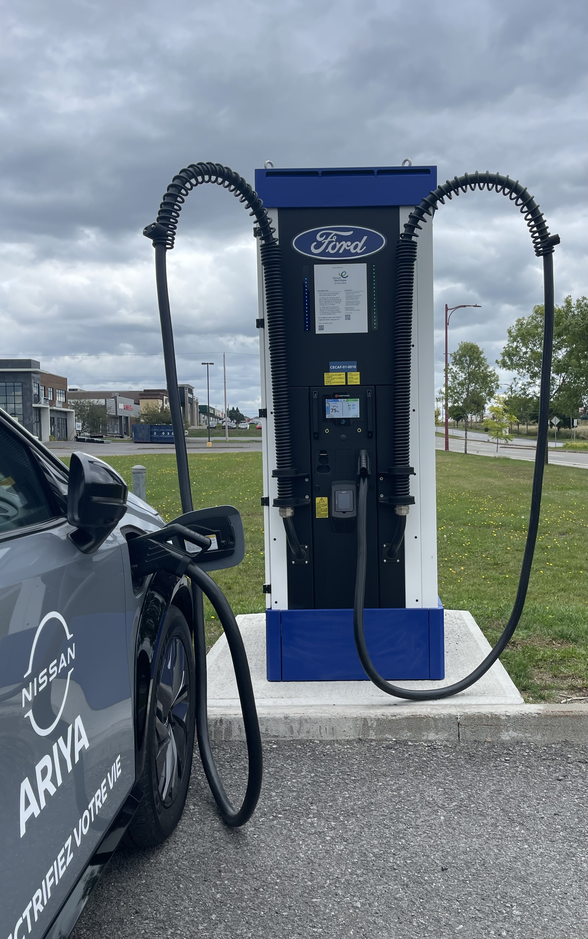
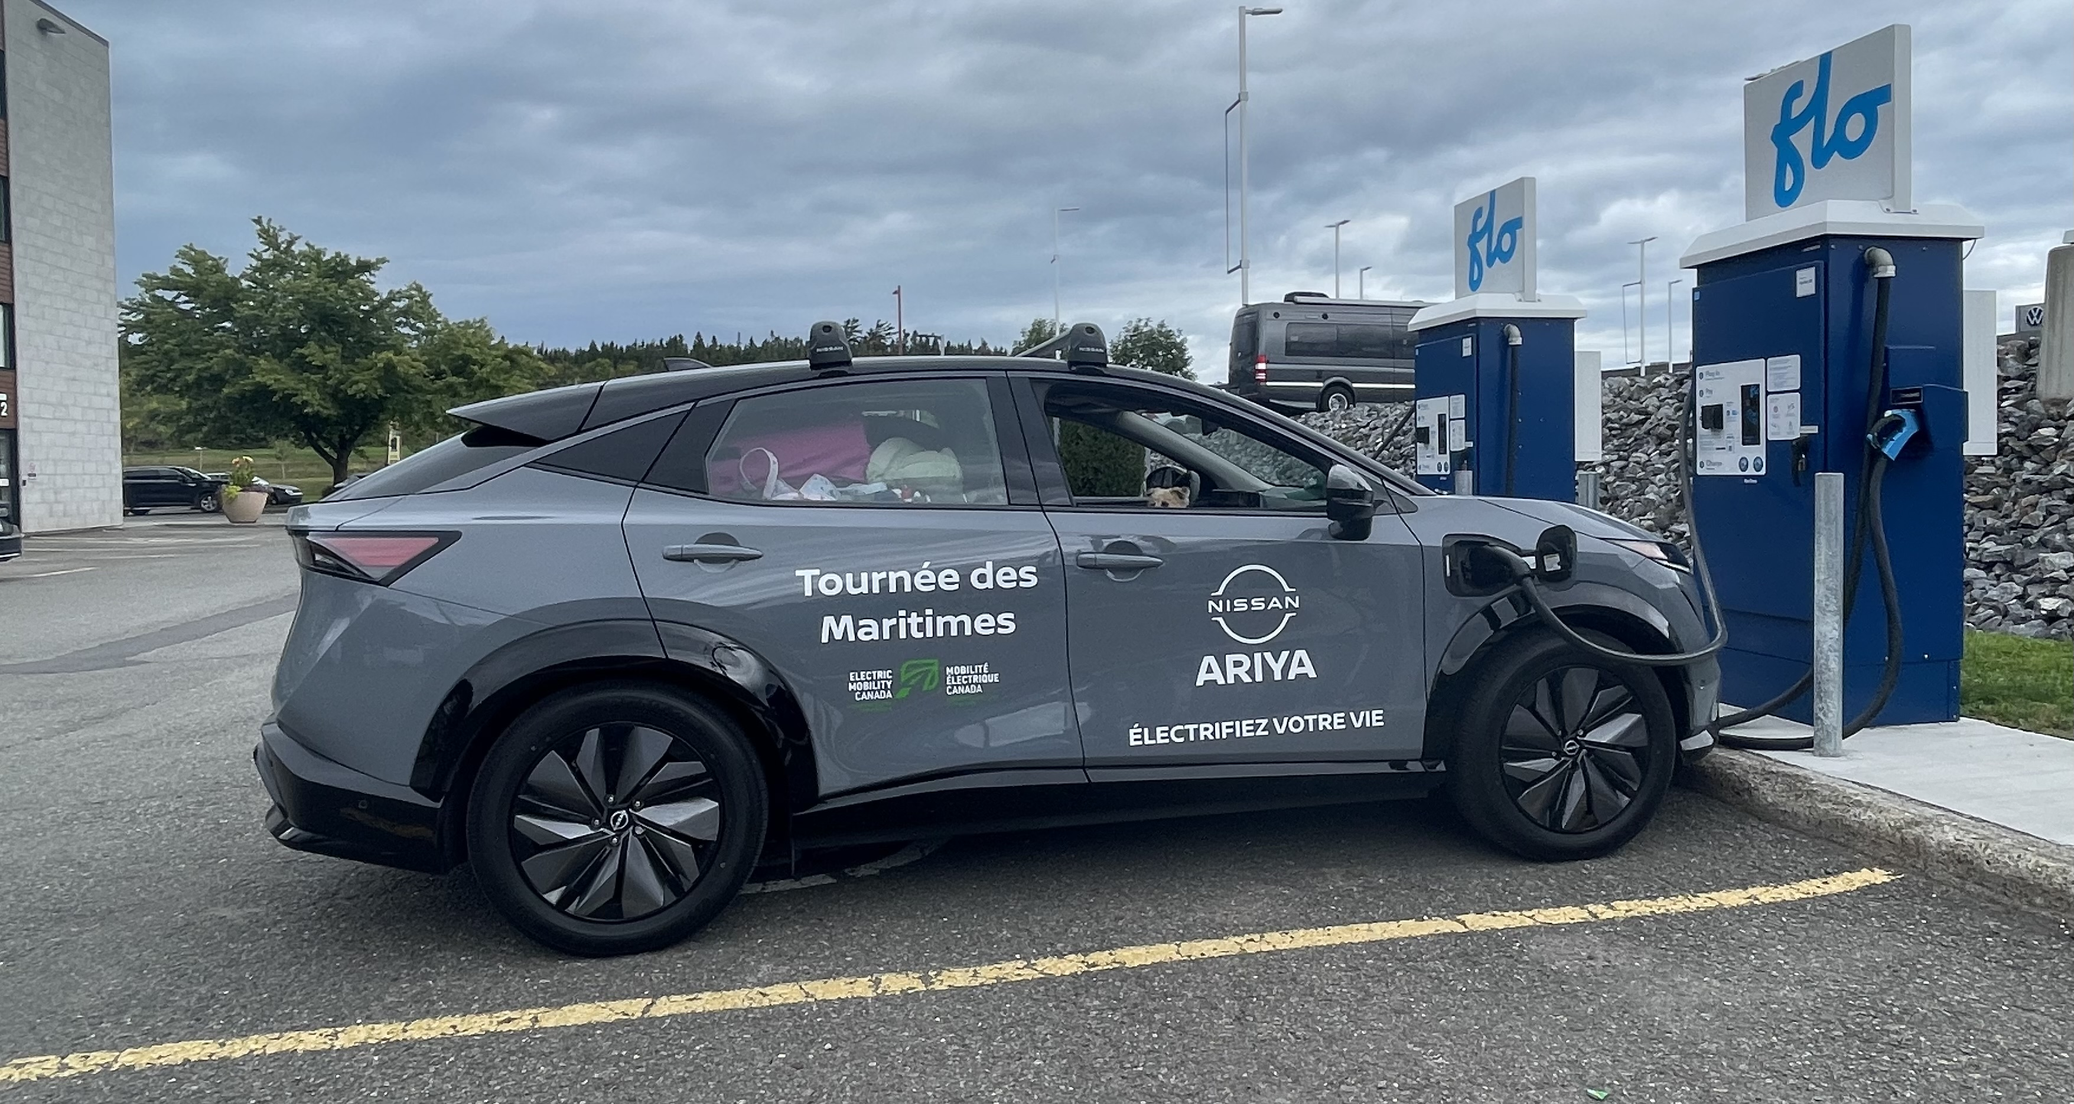
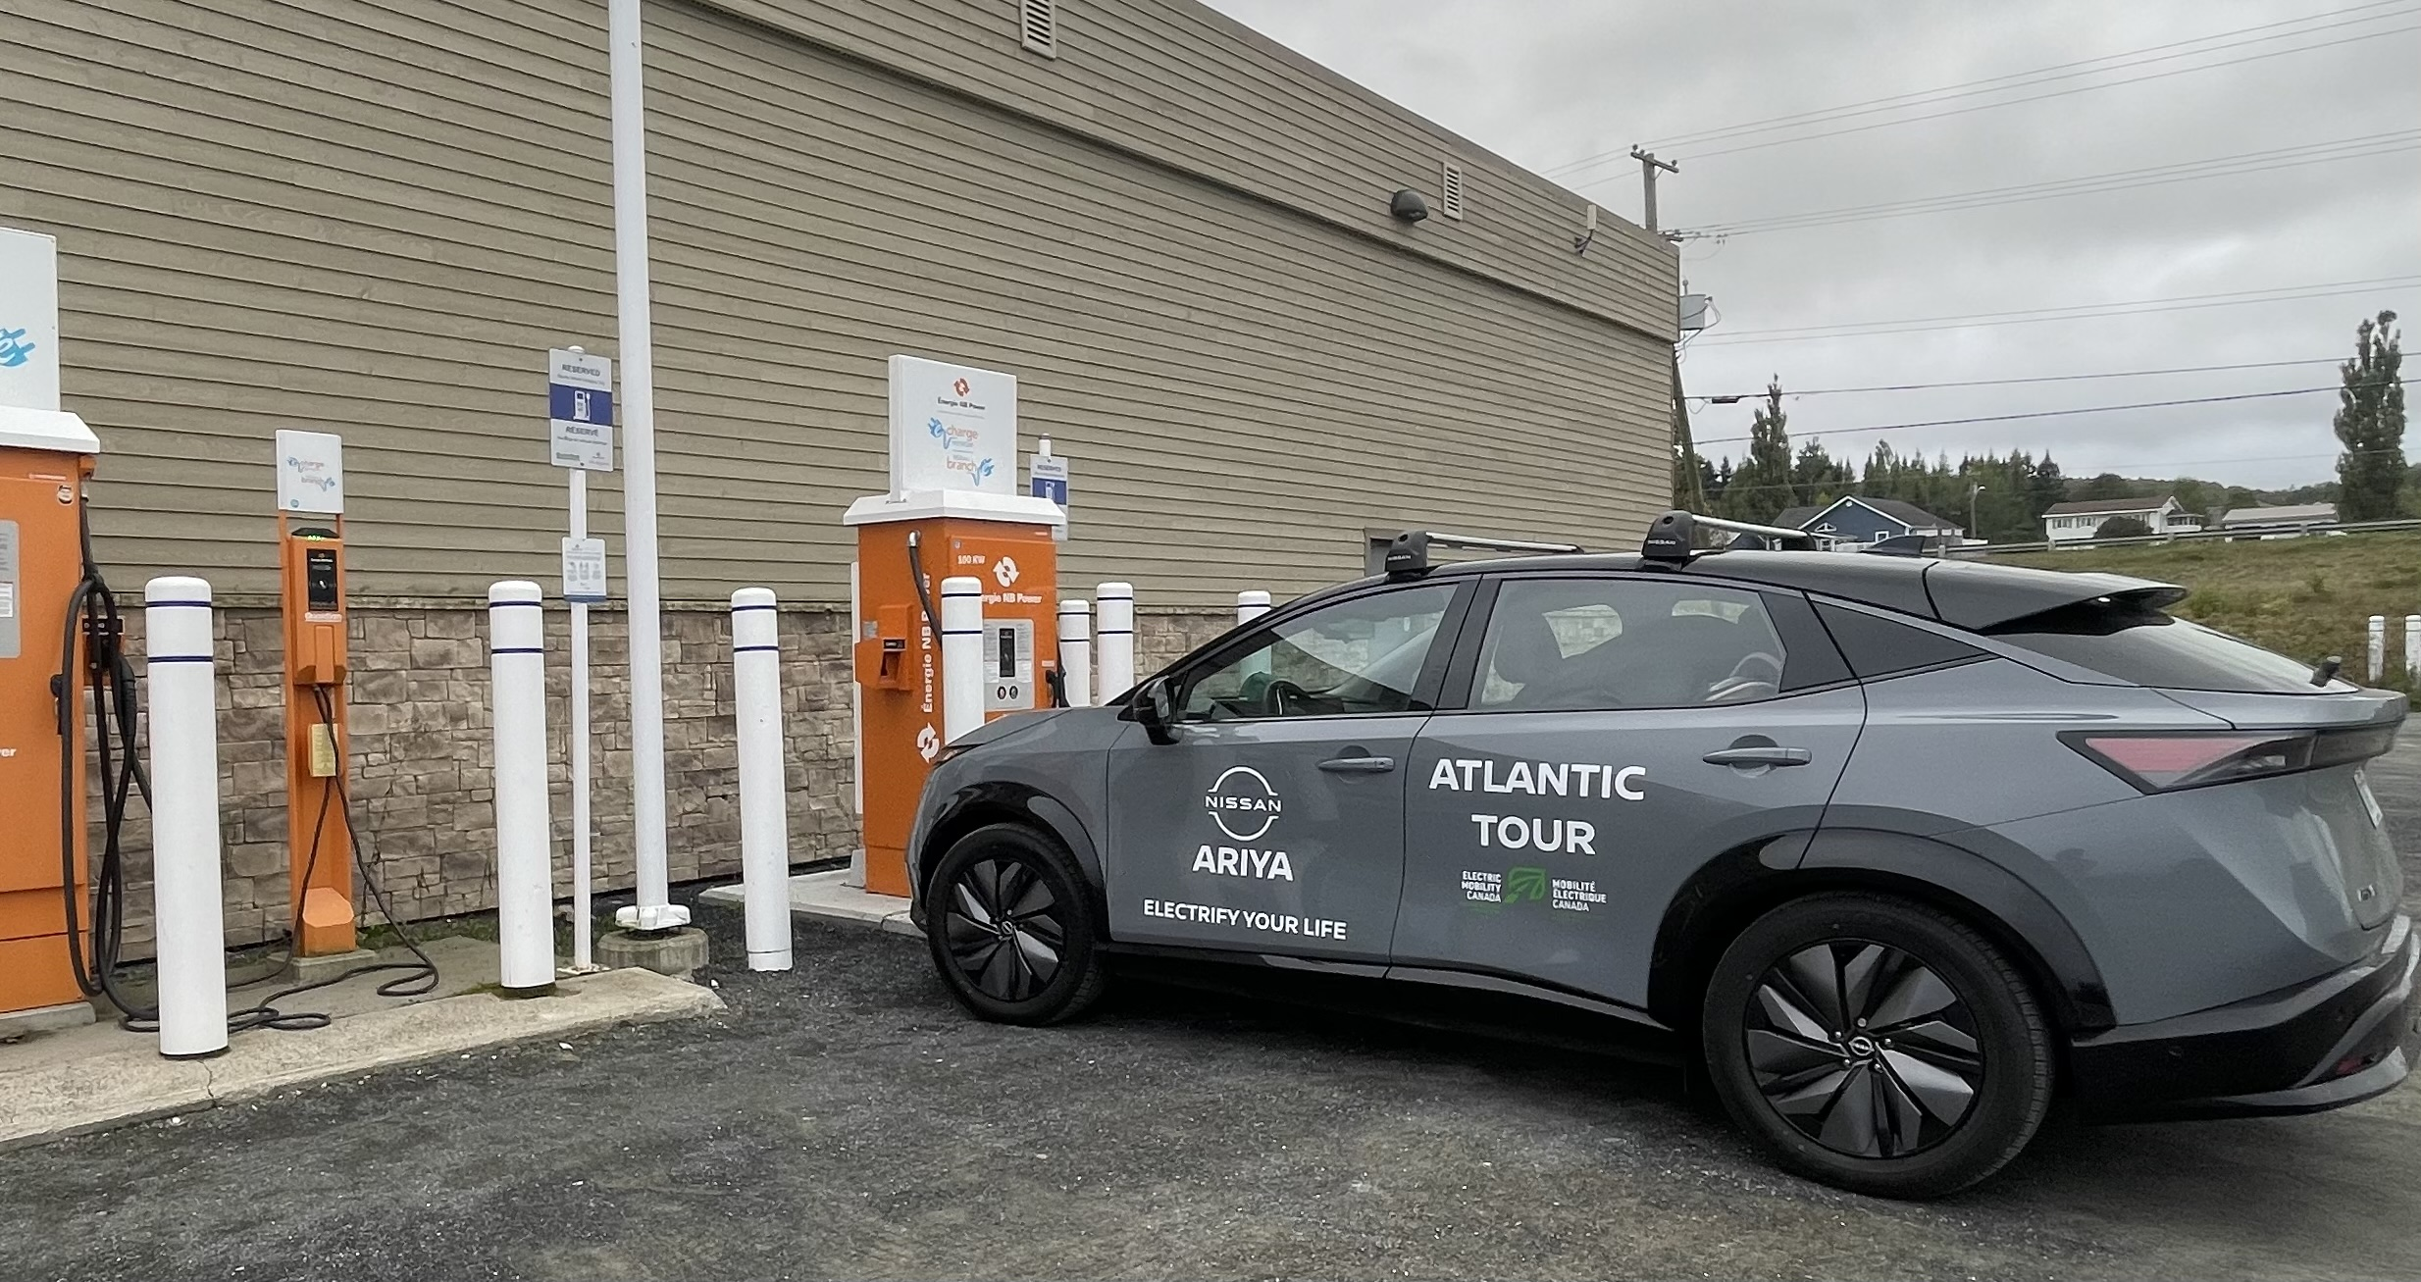
Circuit Électrique
FLO
NB Power

Slide 9
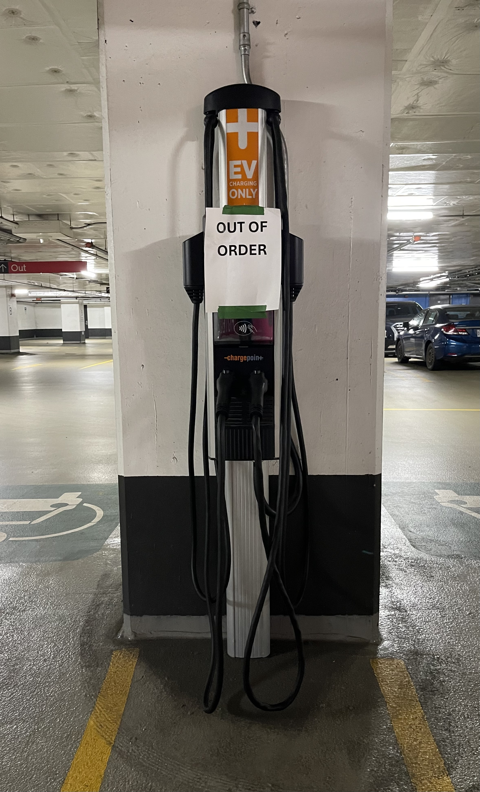
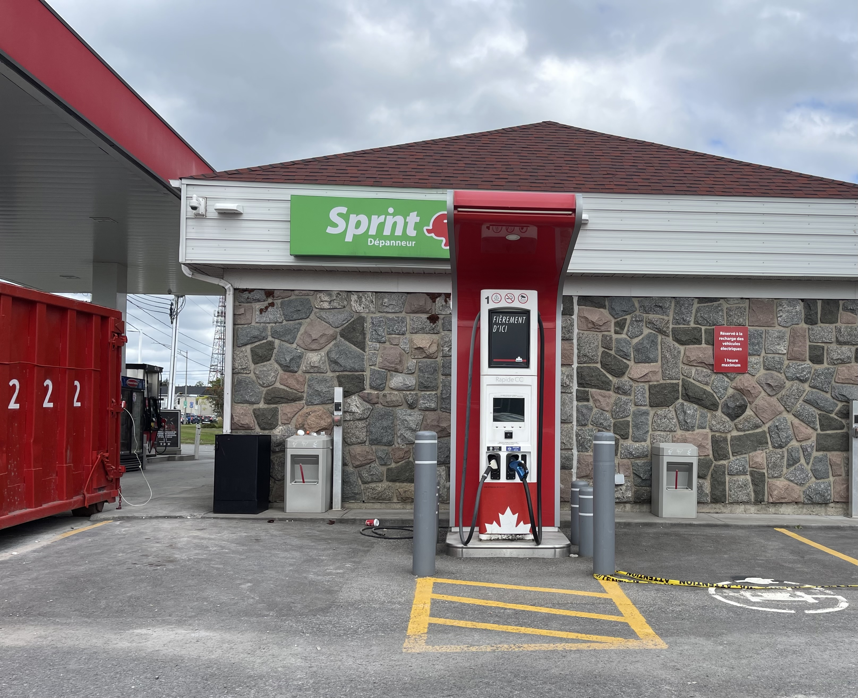

Slide 10

Sample: 6150 Canadians

Slide 11
MHDV ecosystems gaps / Louise

Slide 12
Rural EV driver campaign / short video / Anna & Alexis

Slide 13
Dealer training campaign
- EV mythbreakers
- Les casseurs de mythes
Court video / Anne et Alexis

Slide 14
New members in 2024 / liste
Rima

Slide 15
Annonce Nissan mettre image du véhicule
+ logo de Nissan
Anna

Slide 16
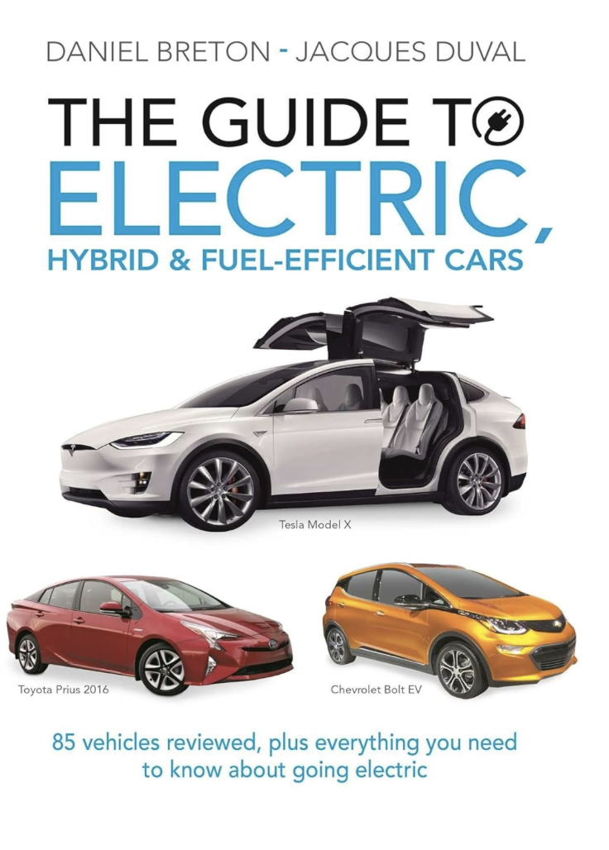
In 2016, I wrote this book in English and French with a chapter addressing 10 myths in 12 pages.

Slide 17
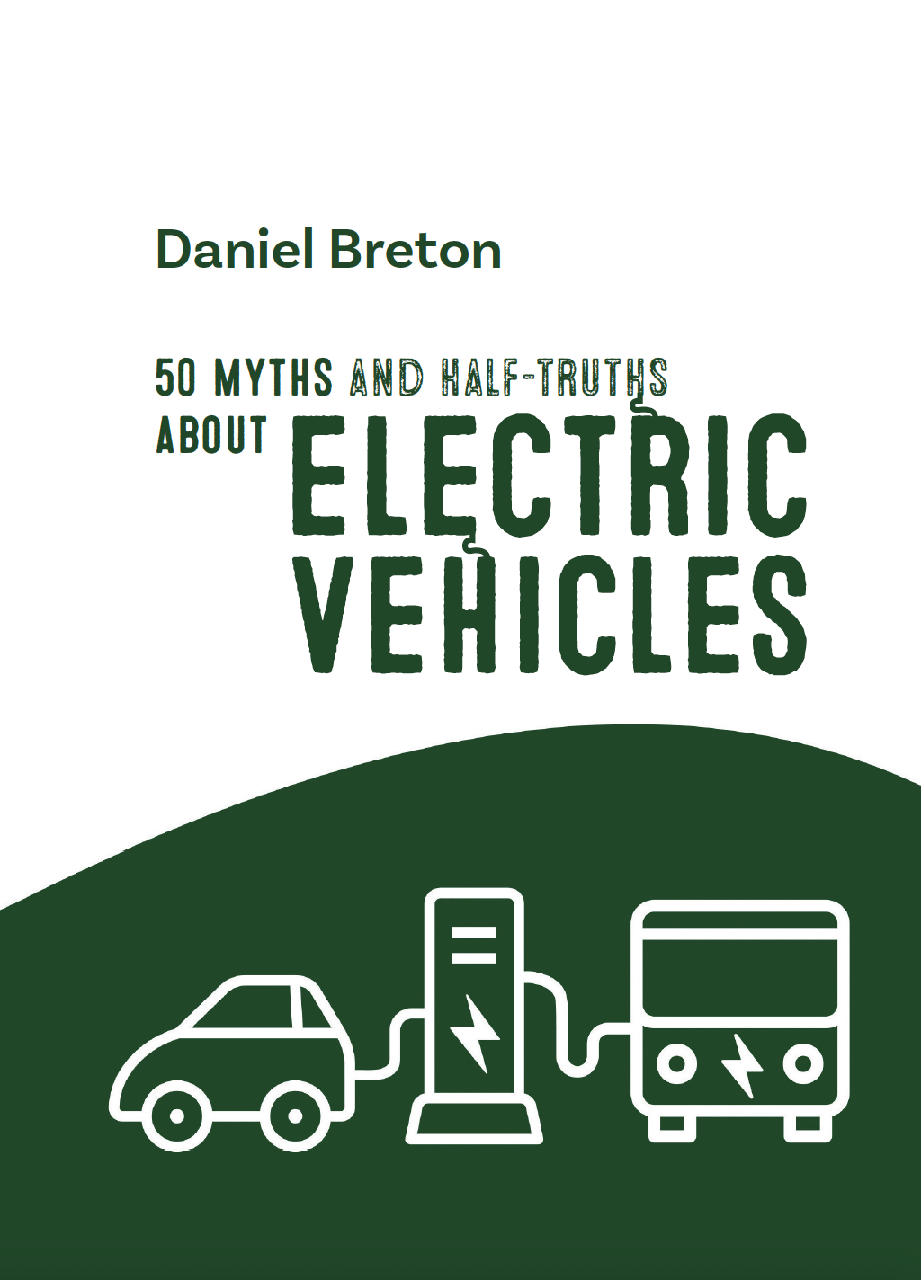
…8 years later, I wrote this new book where I chose 50 of the most “popular” myths and half-truths about EVs… in 230 pages.

Slide 18
This book’s purpose is to become a reference for consumers, industry, journalists and elected official.
It has more than 200 links and reference to studies and has been verified by scientists such as Pierre Langlois, PhD in physics, and the NRC team

Slide 19
The proceeds from this book will go to the creation of the new
EMC EV scholarship program

Slide 20

… et pour ceux et celles qui lisent le français, le livre est aussi disponible dans la langue de Molière.

