Slide 1
EVVE 2025
Theme and Branding

Slide 2
EVVE 2025 Theme and Branding
Beginning in 2025, EMC’s conference will carry over the same event title year-over-year. EMC’s conference will be publicly referred to across all channels as EVVE (YEAR): EMC’s national conference.
The title will remain the same in future years, with the only change being the event year.
The conference brand will remain the same every year, with slight changes to the logo and conference colours to maintain regional integrity and distinguish each individual conference.
Basic design elements (fonts, icons) will remain the same every year

Slide 3
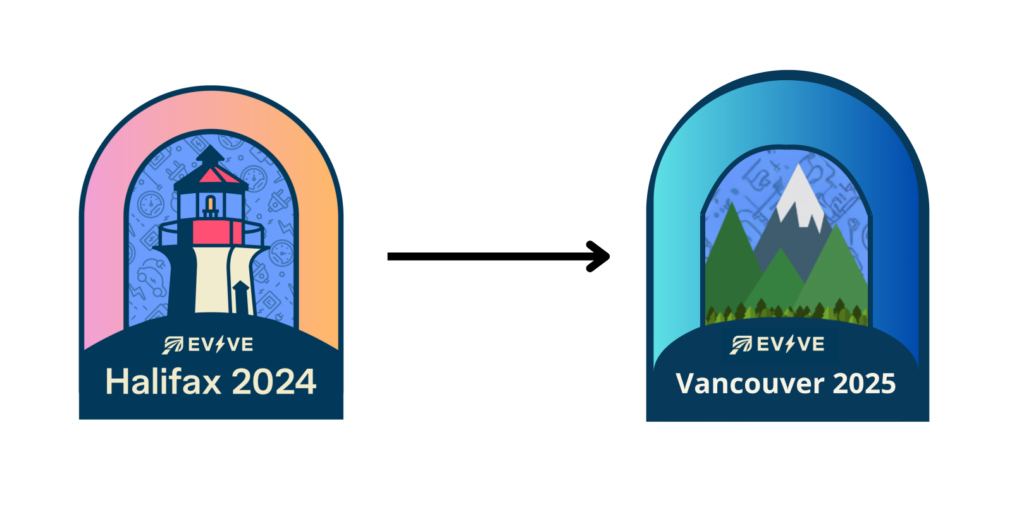

Slide 4


